Slide 1
Version Control
WEEK 1
Advanced Native Mobile Programming 1604C062

Slide 2
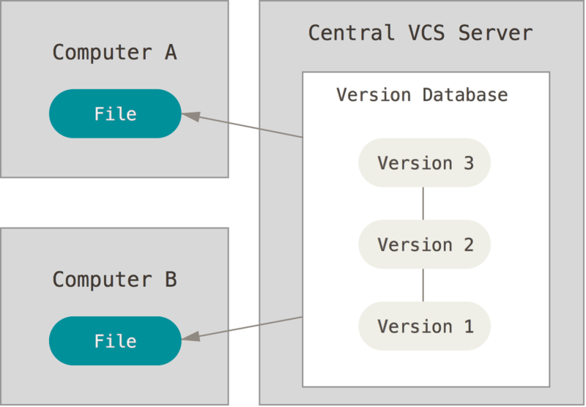
VERSION CONTROL
Version control, also known as revision control or source control, is the management of changes to documents, computer programs, large websites, and other collections of information.

Slide 3
VERSION CONTROL
Track developments and changes in your files
Record the changes you made to your file in a way that you will be able to understand later
Experiment with different versions of a file while maintaining the original version
‘Merge’ two versions of a file and manage conflicts between versions
Revert changes, moving ‘backward’ through your history to previous versions of your file

Slide 4
TERMS
repository
contain a collection of files of various different versions of a Project.
There are two kind of repositories:
Local repository
Remote repository

Slide 5
TERMS
clone
Create a new repository containing the revisions from another repository.
commit
To write or merge the changes made in the working copy back to the repository.
push
Copy revisions from the current repository to a remote repository.
pull
Copy revisions from a remote repository to the current repository.

Slide 6
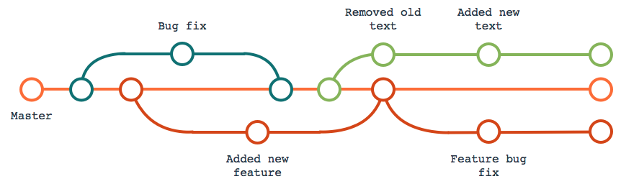
TERMS
branch
A separate working copy of files under version control which may be developed independently from the origin.

Slide 7
TERMS
merge
An operation in which two sets of changes are applied to a file or set of files.

Slide 8



VARIOUS VERSION CONTROL SYSTEM
GIT
MERCURIAL
SUBVERSION
used for source code management in software development. Created by Linus Torvalds in 2005
written in python and intended for software developers
abbreviated as SVN. Founded in 2000 by CollabNet, distributed as open source under the Apache License

Slide 9
POPULAR GIT REPOSITORY
github
gitlab
bitbucket
sourceforge

Slide 10

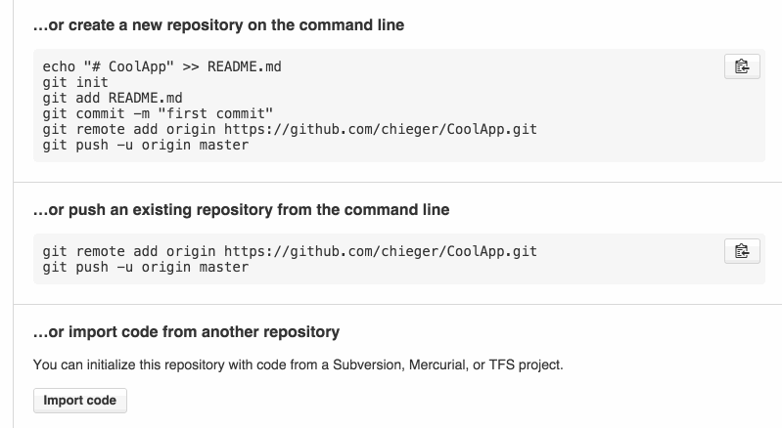
OPERATING GIT
Using terminal or command prompt

Slide 11
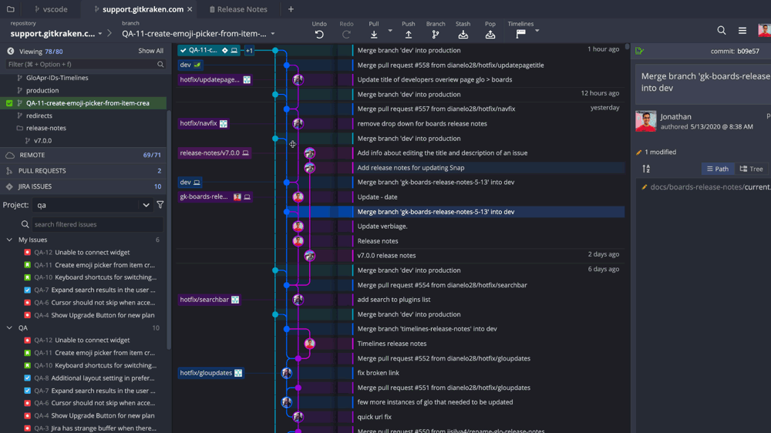
OPERATING GIT
Using GUI

Slide 12

ANDROID STUDIO
Android Studio has an integration with Git for source control management.
It means you can do the different Git operations (commit, push, pull, branch, etc.) from inside Android Studio

Slide 13
GROUP ASSESSMENT
Make a group of maximum three students
Follow all steps on the next slides
Group leader must create a repository
Practice git operation (pull, push, clone, merge, branch, checkout, and so on) have been executed on one of repositories
Group leader must submit / writes github repository URL of all member at ULS
Deadline: next week

Slide 14
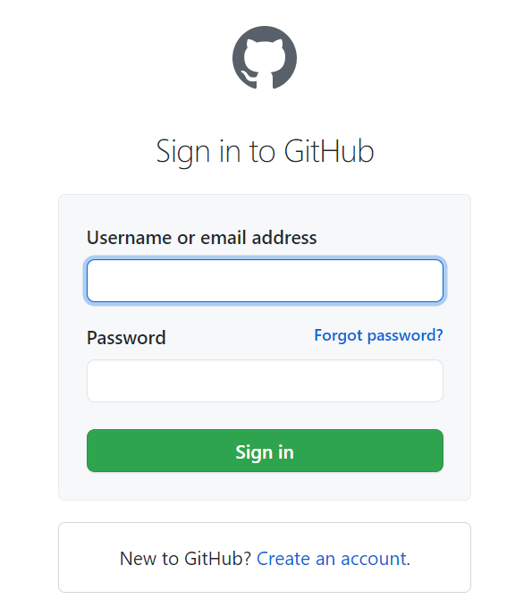
CREATE GITHUB ACCOUNT
Go to https://github.com/login, click on “Create an account” link to create a new github account. Follow all steps.
Don't forget to try sign in into github after completing account creation. (if you already have github account, you may skip this step)
YOUR LOGO

Slide 15
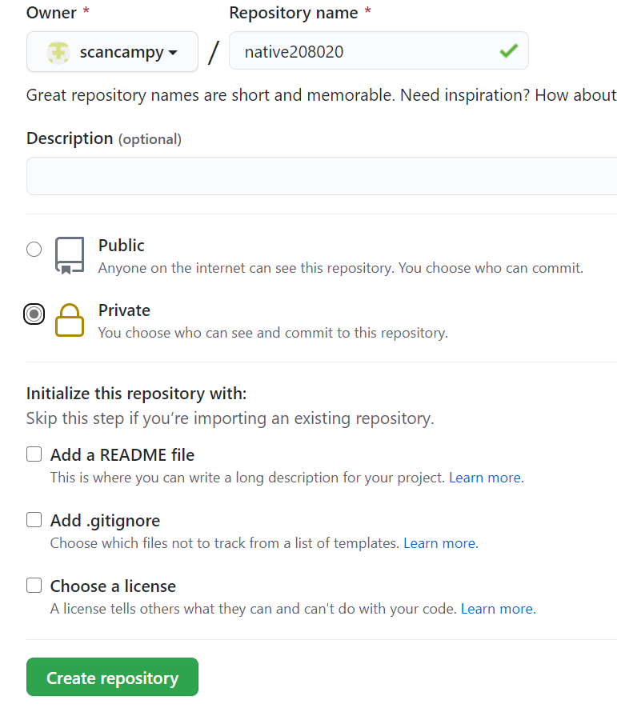
CREATE NEW REPOSITORY
Once sign in into github, click new button to create new repository
Write repo name (without space) native[NRP]
Choose public repo
Click create repository

Slide 16
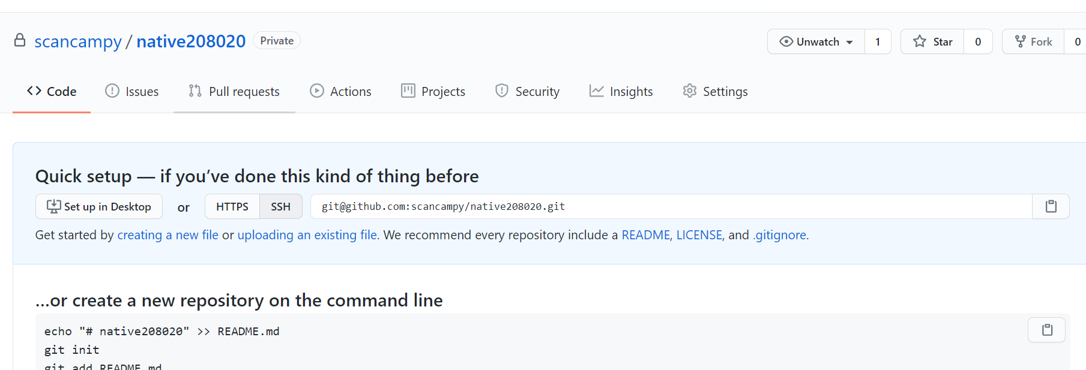
NEW REPOSITORY CREATED
New empty (remote) repository created

Slide 17
Add Collaborator
Open Github website and go to your repository.
Add your friends as collaborator so that your friends could push something. Otherwise, they could pull only.

Slide 18
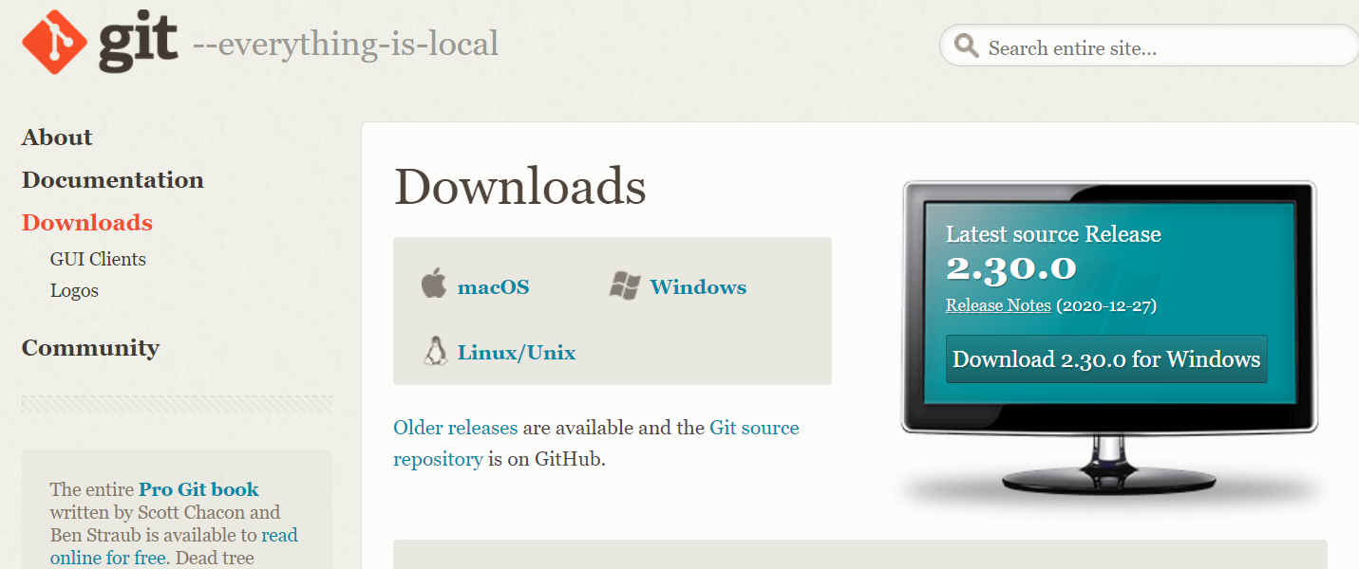
DOWNLOAD AND INSTALL GIT
Go to https://git-scm.com/downloads to download Git system to your computer
Install and follow the default settings You may follow installation tutorial here: https://phoenixnap.com/kb/how-to-install-git-windows

Slide 19
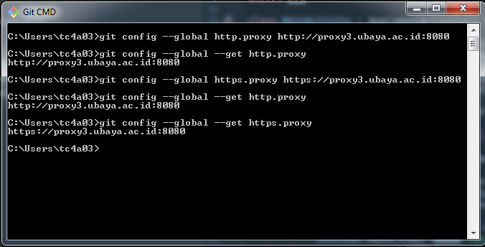
CONFIGURE GIT TO WORK WITH PROXY
Open Git CMD from windows search
Enter configuration command below:
git config --global http.proxy http://proxy3.ubaya.ac.id:8080
git config --global https.proxy https://proxy3.ubaya.ac.id:8080
To view current git config, please enter the following commands:
git config --global --get http.proxy or git config --global --get https.proxy
To clear current git config :
git config --global --unset http.proxy or git config --global --unset https.proxy

Slide 20
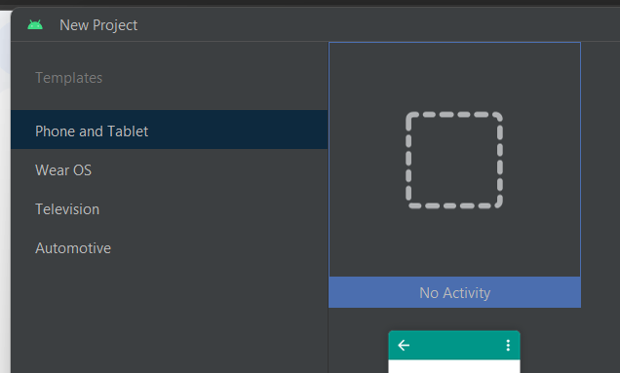
CREATE NEW ANDROID STUDIO PROJECT
Attention! For Girrafe user, please select “No Activity”

Slide 21
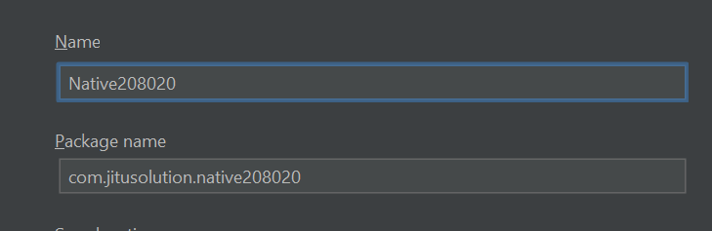
CREATE NEW ANDROID STUDIO PROJECT
Create new project, use empty activity, and name project as Native[NRP] or whatever you name that you like

Slide 22
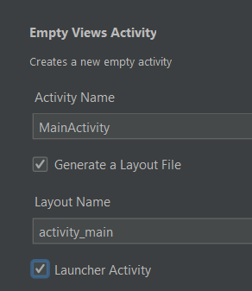
ADDING NEW ACTIVITY
Since we don't have any activity yet, please add one. Right click on package name > new > activity >
Make sure activity name set to “MainActivity”
Tick the “Generate Layout File”
Tick the “Launcher Activity”

Slide 23
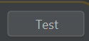
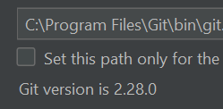
CHECK GIT INTEGRATION
Next, we need to test whether Git is configured in Android Studio
Click file > settings
Type git in search bar
Click “test” button
If you can see git version, means that android studio is configured properly with Git

Slide 24
INTEGRATED GIT INTO PROJECT
Close setting dialog. Next, we need to enable VCS integration into our current project
Click VCS > Enable Version Control Integration
Popup dialog shown, choose git and press OK
Now a new repository with “master” branch have been created on your local drive

Slide 25
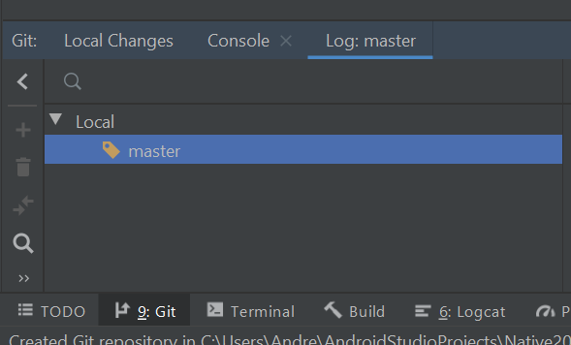
GIT TAB
New git tab shown on the bottom part of android studio
Click log tab
Notice that new branch “master” created

Slide 26
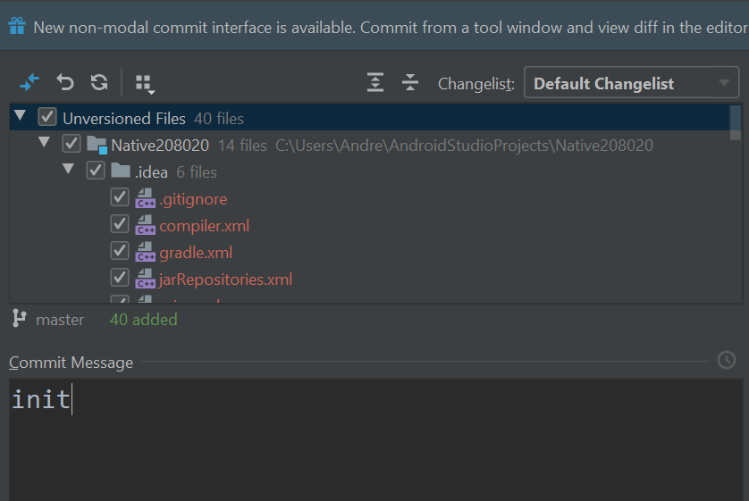
STAGE & COMMIT
The project is ready to use with Git version control. To stage and commit your changes, go to VCS > Commit.
Tick this checkbox
Current working branch
Write messages here

Slide 27
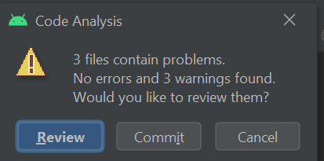
STAGE & COMMIT
Press commit button. Code analysis will show warning dialog like this. Warnings usually related with unfinished TODO, warning on UI or others. For now just press Commit

Slide 28
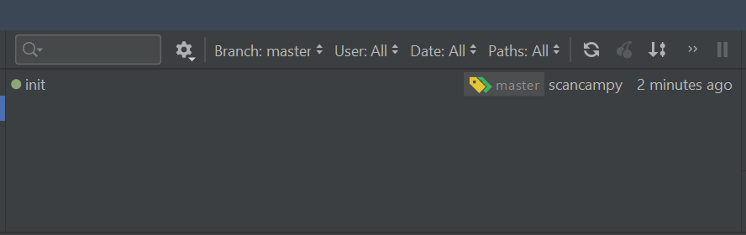
STAGE & COMMIT
Notice in git tab log, a new commit shown

Slide 29
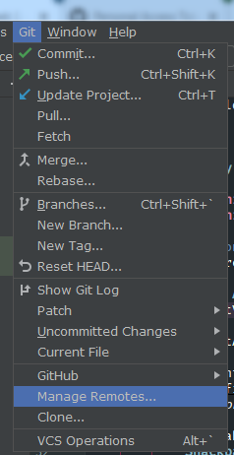
SETUP REMOTE CONNECTION
Previously we only staged and commited files into our own local repository
We need to push our commit to remote repository
To configure remote repository click Git > Manage Remotes

Slide 30
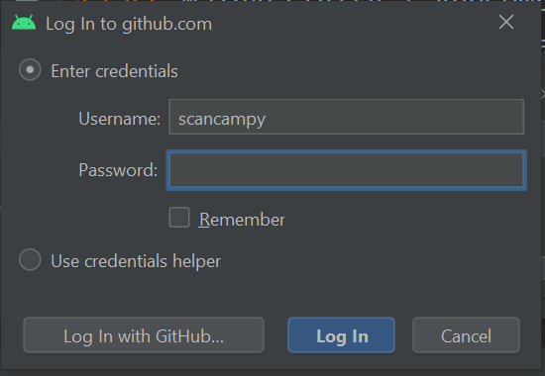
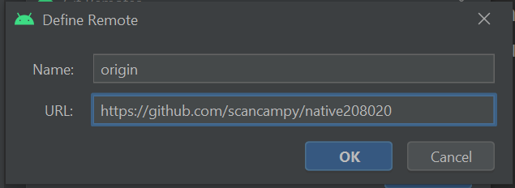
SETUP REMOTE CONNECTION
Click on + button, enter URL of your github repository that you created previously. Press OK
If authentication dialog shows up, you may need to provide github username and password.

Slide 31
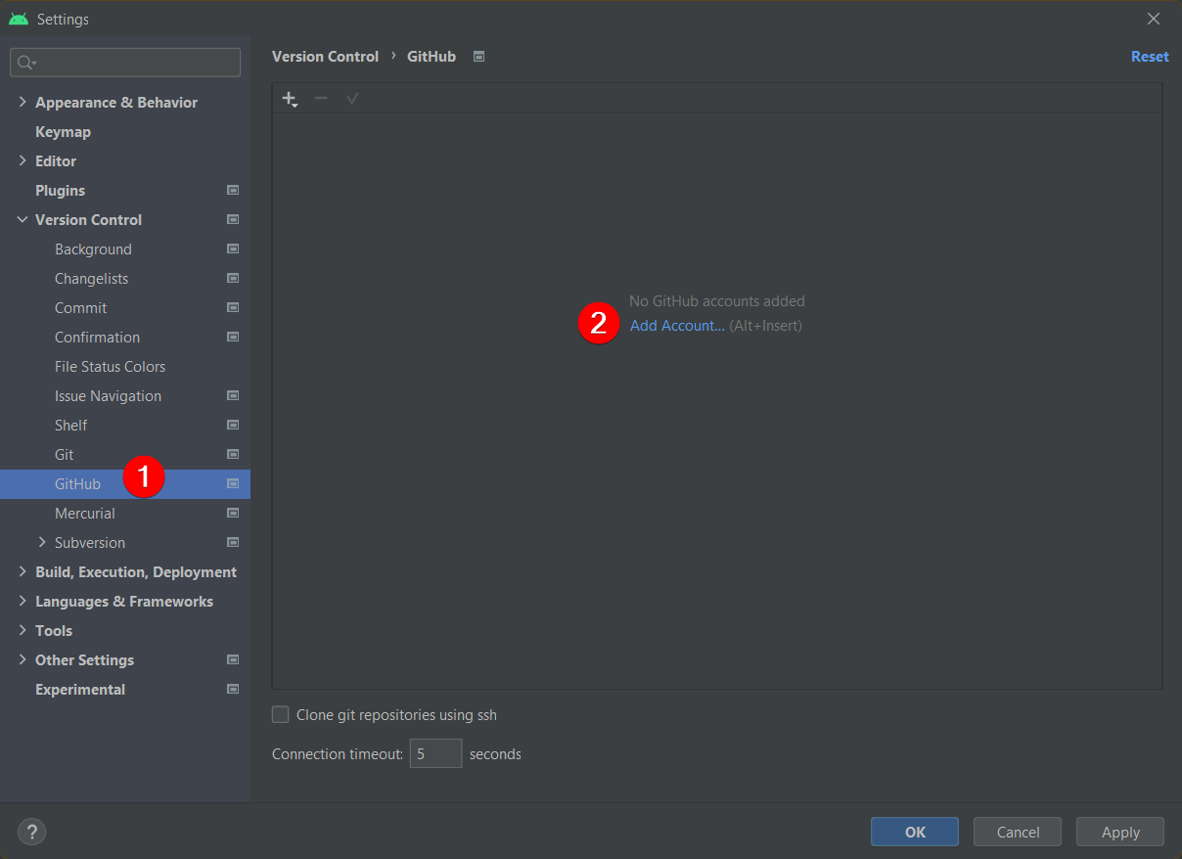
GITHUB TOKEN
Latest github policy requires you to login with github generated token. In that case you must generate a token to enable authentication.
Add from File > Settings, search for GitHub, then click Add account
Make sure you have logged in to GitHub on your browser

Slide 32
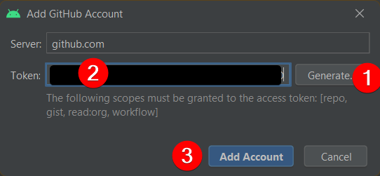
GITHUB TOKEN
Click Generate. Your browser window will open. Leave all settings, then just click Generate Token.
Copy the generated token you see on the browser to Android Studio,
then click Add Account.

Slide 33
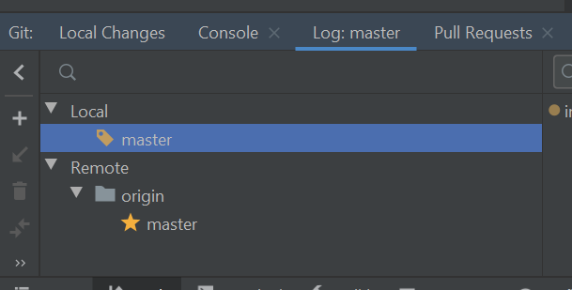
PUSH THE CHANGES TO REMOTE
To push your local changes to the remote repository, go to VCS > Git > Push
And then press push button again to begin push operation
If success, you can see two repositories (local and remote) shown on git log tab

Slide 34
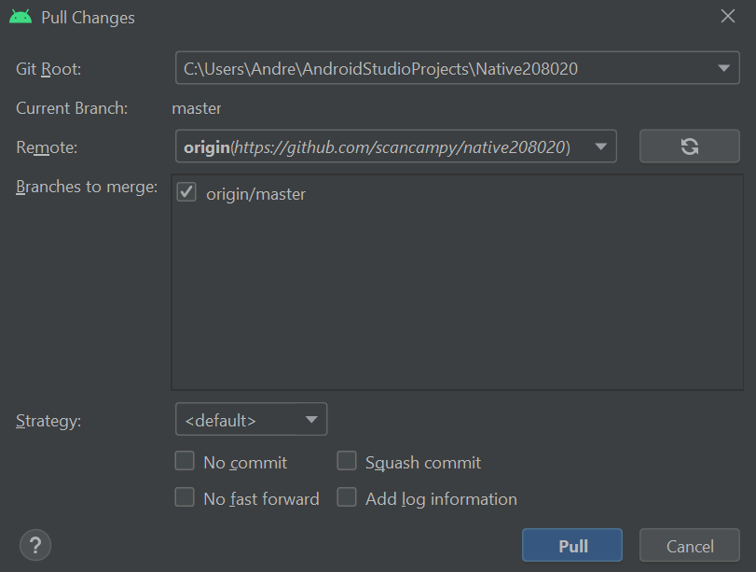
FETCH THE CHANGES FROM REMOTE
To download the latest changes from remote, go to VCS > Git > Pull

Slide 35
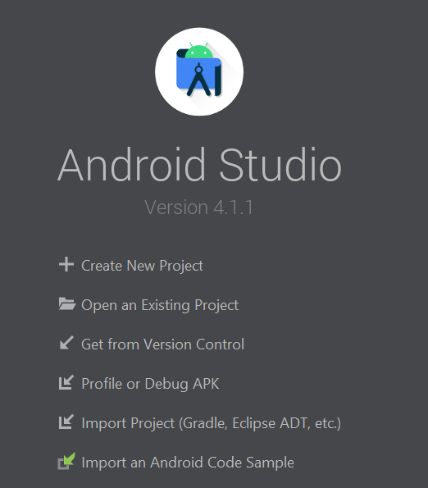
CLONE EXISTING PROJECT
First close all project in android studio
On the Android Studio Welcome screen, click on “Get from Version Control” menu

Slide 36
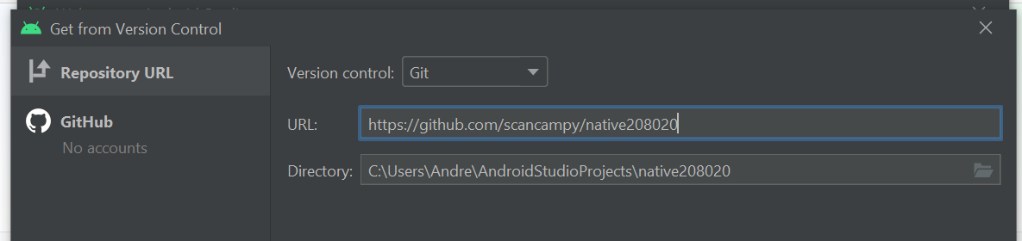
CLONE EXISTING PROJECT
Copy paste your friend repository URL into URL textbox. Make sure your account already have access.

Slide 37
CREATE BRANCHES
Branching is used to maintain stability while isolated changes.
Usually branch used for working on bug fixes, develop new features, integrate new versions after they have been tested in isolation

Slide 38
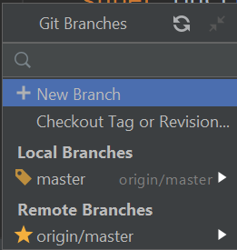
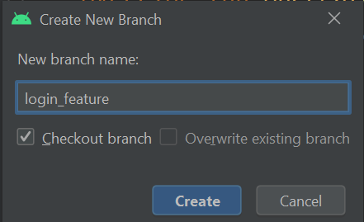
CREATE NEW BRANCH
Go to VCS > Git > Branches.
Choose + New Branch
Name new branch
Press create
Checking out a branch updates the files in the working directory to match the version stored in that branch, and it tells Git to record all new commits on that branch

Slide 39
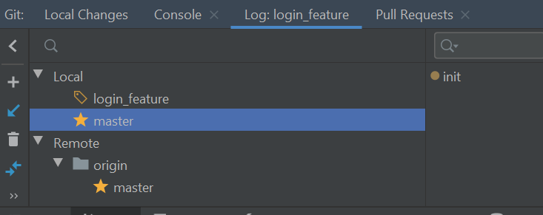
NEW BRANCH CREATED
Notice that now in local repository, there are a new branch “login feature”
Any commit and push will affect this new branch

Slide 40
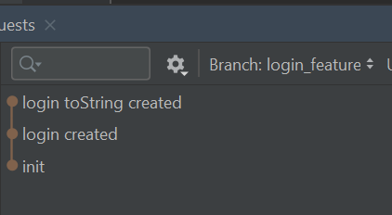
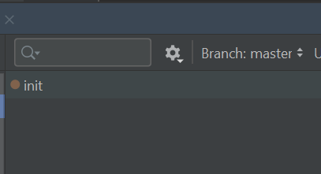
BRANCH
Below images are example of new “login_feature” branch already had two commit.
Master branch still only have 1 commit “init”

Slide 41
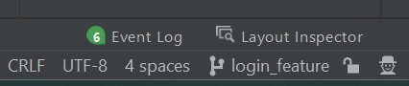
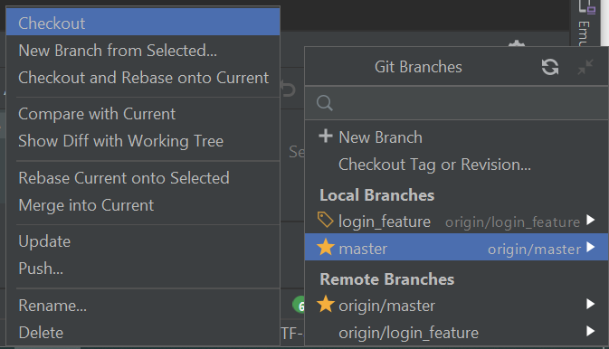
SWITCH/CHECKOUT BETWEEN BRANCH
Its very easy to switch between branch.
Look at the bottom right corner and you’ll see the current working branch
Click on it to reveal all branches.
Click on branch that you want to switch/checkout
Choose checkout

Slide 42
MERGE BRANCH
Merging is Git's way of putting a forked history back together again
Login_feature
branch
Master
branch
Merged

Slide 43
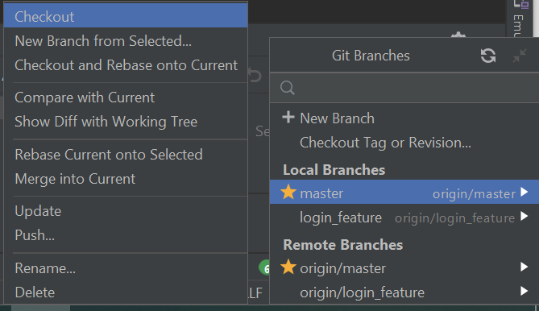
MERGE BRANCH
Let's say we want to merge login_feature branch into master branch
To do that look at the bottom right corner, click on the branch name
Choose master branch and click on “Checkout and Rebase onto Current”

Slide 44
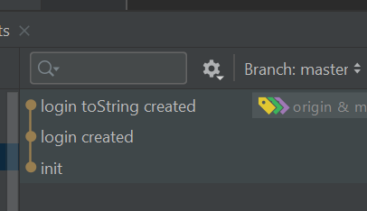
BRANCH HAVE BEEN MERGED
If you look on git log tab, you will see that “master” branch have been merged with “login_feature”

Slide 45
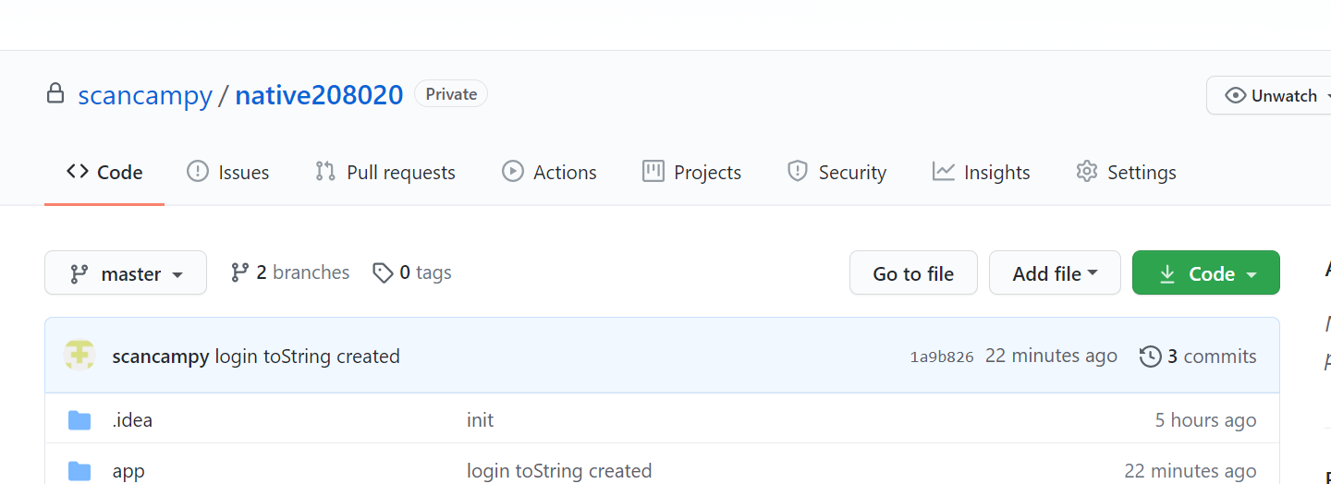
ALLOW ACCESS FOR OTHER TEAM MEMBER
Since your repository is private, you must manually add other github account to give access privilege
To manage user access, open your repository from browser and click on “Settings”

Slide 46
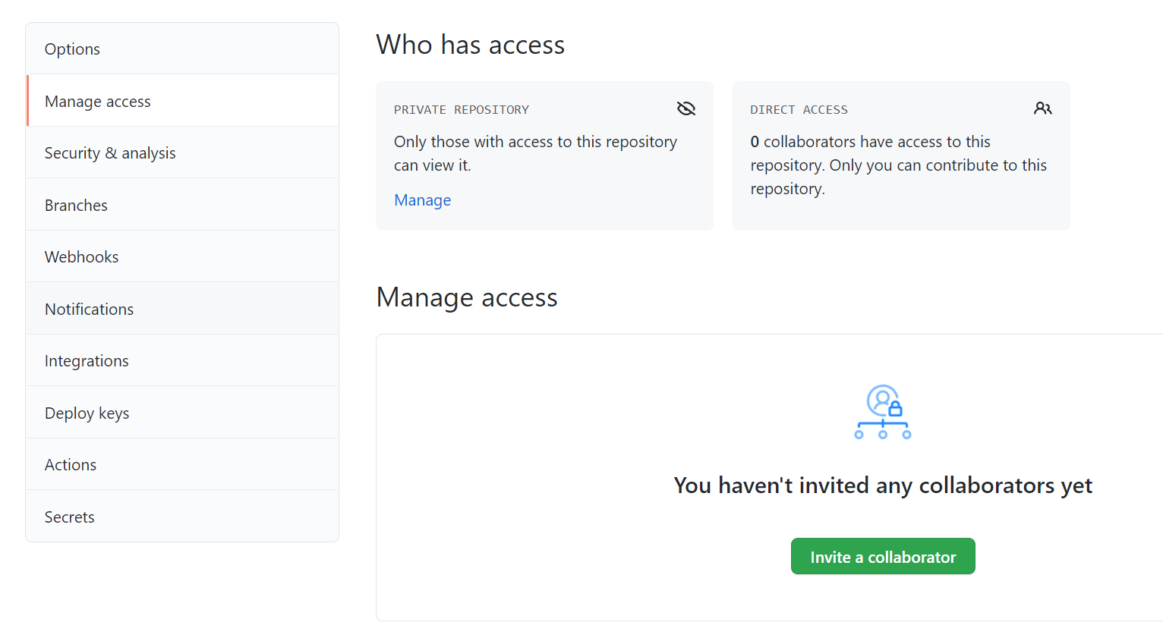
ALLOW ACCESS FOR OTHER TEAM MEMBER
Click menu Manage access
Click invite a collaborator

Slide 47
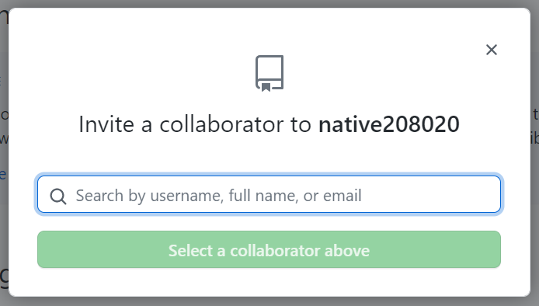
ALLOW ACCESS FOR OTHER TEAM MEMBER
Write your friend email or github username. If success, your friend will have access to run git operation on this repository.

Slide 48

CLONE EXISTING PROJECT
There are tons of available github project on the internet.
Using android studio you can easily clone github project and start work on it
In this case lets clone your friend repository
Images of Clone Trooper (courtesy of Starwars Universe)

Slide 49
THANKS!
DO YOU HAVE ANY QUESTION?
andre@staff.ubaya.ac.id
Please keep this slide for attribution.

Slide 50


